Slide 1
CUMC UPWARD BASKETBALL 2024
Coaches Training
December 4, 2023

Slide 2
Upward’s mission is to promote the discovery of Jesus through sports.

Slide 3
Be organized and ready for practice – Use the Upward Coach Playbook (practice plans, skills and drills recommendations, and devotion guides) as a primary resource. Set aside time to prepare for practices.
Teach the rules of basketball – For players to learn and grow, they need to be taught the rules.
Instill sportsmanship with a competitive spirit and a growth mindset - Your players need to learn how these important elements work together.
Sportsmanship – teach and demonstrate respect for coaches, referees, parents, teammates and opponents. Coaches MUST always exhibit this example
A growth mindset - help your players to focus on growing and improving at each practice and game, having fun and giving their best effort.
Communicate effectively – Communication is crucial.
Keep parents informed each week with an email or text (TeamSnap).
Speak with players on their level and make sure to demonstrate and teach drills.
Use positive language, point out where a player has made improvements and encourage effort to motivate.
What is Expected of Coaches

Slide 4
Teams in 1-6th grade divisions have a single 1-hour practice each week; no weekday practice for K division. No additional practices allowed.
Practice time slots (please begin and end on time):
  5-6PM
  6:15-7:15PM
  7:30-8:30PM
Court assignments are in TeamSnap
Coaches with 5PM practice slots will need to “open” the gym (keys from lock box, lights on, move goals, ball racks\pennies\cones out); Coaches with 7:30 practices will “close” gym (move goals back to the corner, put equipment in closet, turn off lights, lock exterior door, put keys back into the lock box)
Goal heights are K = 7.5’; 1st-2nd = 8’; 3rd-4th= 9’; 5th – 6th = 10’. Adjust heights for your practice (labeled on the goal)
Practice

Slide 5
Practice Huddle Devotion
The Practice Huddle (Devotion) is important – If you need help, ask. This devotion time is an important ministry touch point of the league.
See Section 4 of the Coach Playbook for the ministry touchpoints used during practice.
At the midpoint of practices (5:30, 6:45, 8:00), all teams will conduct a 8-10 minute Practice Huddle / Devotion. The devotions teach the character of Christ through the virtues he modeled.
Each week, players will receive a green practice sticker star for their participation in the Practice Huddle (hand out at the end of practice).
Other ministry touch points include practice cards and the gospel video. Make sure to distribute the video at the next to last practice.
Devotions are conducted on your practice court in the ROC: 10 minute quiet period for everyone
Devotion #1 should be part of your first weekday practice (week of December 11th)
Devotion #2 should be part of your practice on Saturday, December 16th
Devotions will continue at each weekday practice thereafter

Slide 6
Gameday
All K-4th grade games begin and end at the top of the hour. 5th-6th grade games last 75 minutes. Each player will be introduced before each game. You can help us by…
Having your team gather 15-20 minutes prior to game time in your assigned “locker room”
Write down your players’ numbers and phonetic pronunciations on the handout provided in your classroom
Be ready for starting lineups 10 minutes prior to game time: arrange players according to rotation pattern with starting 5 at front of the line
4 teams will congregate in the hall outside the bathrooms
Players will be introduced individually; games will begin after all 4 teams are on the courts
Refs lead both teams in a prayer circle at halfcourt
1-6 Divisions: 2 halves each made up of 3 6-minute periods; ~7 minute half-time spent in “locker rooms”
K Division: Four 4-minute periods
Post game: Retreat to lock rooms for “Star Ceremony”: exit via side doors, not center doors

Slide 7
Gameday continued…
Games start at 8AM; last game ends after 8PM.
Wristbands on, laces tied (players will be temporarily subbed out for untied shoelaces), jewelry off
Home team wears light color, away wears dark color
Player mismatches during pre-period lineup/handshake; both coaches agree on switches
K-4 Divisions:
  Home Teams provide scoreboard operators (main clock serves both courts but separate scoreboards
    - No score is kept for K and 1/2
5-6 Divisions: Each team needs specific book and clock operator (same person for entire season)
We may adjust game clocks to gain/lose time to stay on schedule

Slide 8
Gameday STARS
Game day stars are multi-colored iron-on stickers that you give to players at the end of each practice and game based upon their efforts:
Red = Defense
Blue = Effort
Gray = Offense
Gold = Sportsmanship
White = Christ-likeness
Your coach box should have 2 stars of each color\game. More stars are available at main table on game days.
Have your assistant coach or a parent take notes during the game so that you can give specific reasons why each child receives a star.
The goal should be to award each player one start of each color by the end of the season
Players place the stars they receive on their t-shirt. Stars can be tracked in the Coach Playbook.
Coach Playbook Page 132 for additional information

Slide 9
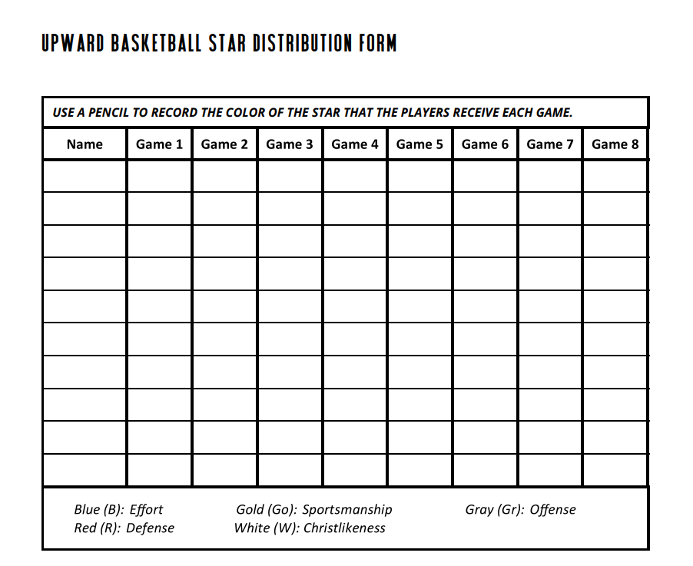
Gameday STARS continued..
Red = Defense
Blue = Effort
Gray = Offense
Gold = Sportsmanship
White = Christ-likeness

Slide 10
Centreville Upward Methodist Church Sports
2024 Basketball Rules

Slide 11
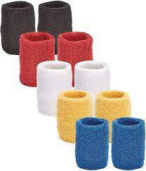
Wristbands
What Makes Upward Unique?
What's the wrist-band system? Players are assessed during evaluations and then assigned a color wrist-band to wear during games. This ensures that players of similar skill level are defending each other. This allows beginners to feel comfortable learning the game, while more advanced players can challenge each other.
Black = Most skilled
White = Least skilled
Player rankings will be due by Sunday, 12/17 (after the 3rd practice)
Weekly rotations will be based on your ranking of players and thus the wristband they will wear.
  Rotations will be available for each team each week on the Upward website “Coach Resources” as well on a google drive
  Please make adjustments as necessary based on availability each week

Slide 12
Player Rankings
Evaluate your players over the first 3 practices (final rankings due Sun, 12/17)
Rank them in order from Most Skilled to Lease Skilled
The pre-draft evaluations can be provided to you if necessary but the eye test from you as the Coach will be the most accurate.
Make adjustments as needed throughout the season if you were off in your early rankings or if players simply improve.
Rankings and therefore wristband colors are meant to keep the matchups as fair as possible.
Regardless of who is on the floor each quarter/period, the black wrist band goes to the most skilled player of those 5 players and white wristband goes to the least skilled player of those 5.

Slide 13
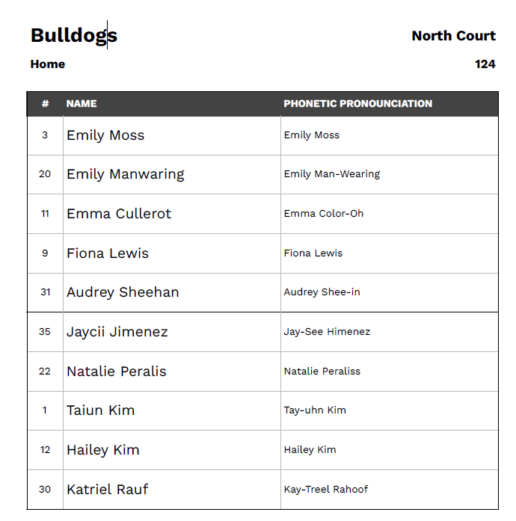
Rotations
Each week’s rotation will be provided by the league based on your full roster.
You will need to make edits as necessary based on availability while still following the rotation, moving players up from the bottom

Slide 14
Rotations continued…
Blank rotation form provided by the league
UPWARD ROTATION
Rank | Jersey # | Name | 1 | 2 | 3 | 4 | 5 | 6 | OT
BLK
BLU
RED
YEL
W
F
G
H
I
J
K

Slide 15
Rotations continued..

Slide 16
Gameday RULES
Rule | K | 1st-2nd | 3rd-4th | 5th-6th
Home team begins with ball | X | X | X | Jump Ball
Possessions alternate on jump ball | X | X | X | X
Possession at start of each period is based on possession arrow | X | X | X | X
Running clock throughout game | 4 min qtrs | 6 mins periods/3 per half | 6 mins periods/3 per half | **8 min qtrs
Coaches must adhere to rotation pattern | X | X | X | **
1 timeout per half |  |  |  | X
Teams switch goals at halftime |  |  | X | X
Score is kept (rolling 20 point mercy rule) |  |  | X | X
3-minute overtime period |  |  | X | X

Slide 17
Gameday RULES continued..
Rule | K | 1st-2nd | 3rd-4th | 5th-6th
Man-to-Man Defense at ALL times – no Zone allowed | X | X | X | X
Players must be within arms reach of their man | X | X | X** | X**
No double teams | X | X | X | X
Help defense is allowed |  |  | X | X
Legal screens are permitted (no sandwich or moving screens) | X | X | X | X
Backcourt violation
Backcourt defense is allowed |  |  | ** | **
No stalling or running out the clock | X | X | X
No isolation plays | X | X | X | X
If a player commits 2 fouls in a period, they must sit out the remainder of the period | X | X | X
Shooting fouls result in FT’s |  |  | X | X
Bonus situation FT’s |  |  |  | X
No score for own goal basket – results in turnover | X | X | X | X

Slide 18
**Help Defense
Not allowed in Kindergarten-2nd Grade
Can leave man to play help defense when:
  Fast break
  Unguarded ball handler in lane
  Help & recover when screened
Must always help & get back as soon as original defender is in position

Slide 19
**Modified Rules: 5 – 6th Grade
Rotation Pattern, sub halfway through each quarter (coaches choice last 4 mins of the 4th qtr)
8-Minute Quarters
Clock stops for injuries, free throws, timeouts and substitutions
Full court press allowed once ball is inbounded
Fouls: Free throw bonus situation is in play & players foul out after 5 fouls

Slide 20
Referees
The ref’s are volunteers age 12 – 60+. They will vary in their knowledge of the game but all will be trained and taught the rules specific to Upward
They will make mistakes, please know this. Give them grace and treat them with respect.
2 ref’s per game
Typically 1 “veteran” ref and 1 young person/new ref
Ref’s will help coach on the floor, especially in the K, 1-2 divisions
Black/blue wristbands will be held to a higher standard than white/yellow wristband
As the season goes on, they will be stricter on traveling, fouls etc

Slide 21
Questions?
Don’t hesitate to reach out to myself, BJ, Chris Granberg and Sean Gray with any questions, concerns or assistance needed throughout the season
We are here to HELP!

